Slide 1

ECEN 3593-001 Computer Organization
Lecture #7
1 February 2021

Slide 2


Agenda
Class Announcements
RISC-V instruction Formats

Slide 3
Class Announcements
Reading for the week
“Computer Organization and Design, The Hardware / Software Interface, RISC-V edition,” by David Patterson and John Hennessy
ISBN 978-0-12-812275-4
Chapter 2, “Language of the Computer”
sections 2.1 thru 2.8
pages 60-108 (sections 2.1 thru 2.8)
RISC-V Specification is in the Course Content Area
Office Hours today 2:00 to 3:00 – Zoom

Slide 4
Class Announcements
Homework #1 is due Thursday, February 4 at 10:00 PM
Phase 2 is posted.
The Target Date is Sunday, February 7 at 10:00 PM
Bonus 1%/day before that. Deduction 10%/day after that.

Slide 5
TA Office Hours
New document in Canvas describing TA Office Hours
2 hours each day of the week except Saturday, based on Doodle Poll results
TAs will have open Zoom meetings you can connect to
Can Slack me any time, and request office hours with me any time
I will open a Zoom meeting from 2:00 to 3:00 today – fell free to join at https://cuboulder.zoom.us/j/4317981384. This will be an experiment.

Slide 6
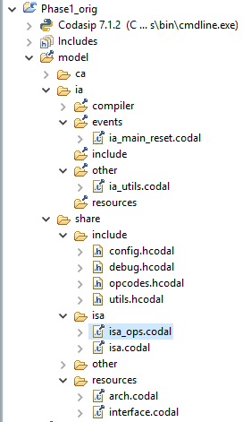
Phase 2 Structure
Main execution loop
Functions used elsewhere
Defines the machine code for instructions
Defines the instruction implementation

Slide 7
Phase 2 Note – Pseudo Instructions
Defined for programming clarity
Instructions which are not part of the ISA, but map to ISA instructions
Examples
mv, x2, x1 -> addi x2, x1, 0
bnez x1, LABEL -> bne x1, x0, LABEL
Defined by i_instruction_alias group in isa.codal (e.g. i_mv_alias)
All created by uncommenting – removal of /* and */
Simplicity!!

Slide 8

Latest Processor Forecast 2023
Big new areas
Hearables (smart earbuds)
Smart Speakers (Home devices)
Smartwatches (all bands)
These were small in 2018

Slide 9
RISC-V: 32-bit Constants
To create the 32-bit constant 0x003d0d48
lui x5, 0x003d0
addi x5, x0, 0xd48
BUT – SIGN EXTENSION causes this to fail – result is
0x003c9d48

Slide 10
RISC-V: 32-bit Constants
How could the compiler handle 32-bit constants?
Modify the lui immediate to compensate
In previous example – want 0x003D0D48
We’re going to add 0xFFFFFD48 to the upper immediate
This is like adding 0x00000D48
And then 0xFFFFF000, which is -0x1000
So add +0x1000 to the LUI value, which is +0x1 to the constant
lui x19, 0x003D1
addi x19, x19, 0xD48
Result – x19 = 0x003D0D48

Slide 11
RISC-V: Upper Immediate Instructions
auipc x27, 0x00001 (Add Upper Immediate to PC)
=> x27 = Current PC + 0x00001000
Allows software to determine the program location in memory
Can access data embedded in the program
The only obvious mistake (to me) in the RISC-V ISA – we really want to add a normal immediate
ECEN 4593-001 lecture 9

Slide 12
RISC-V: Machine Language
Assembly Language is a human readable description of the instructions to be executed
Machine Language is a machine readable description
Patterns of 1’s and 0’s held in the Instruction Memory
What Great Idea of Computer Architecture is apparent here?
Abstraction – Assembly Language is an Abstraction of Machine Language
In RV32I all instructions are 32 bits
Simplicity is the art of design!

Slide 13
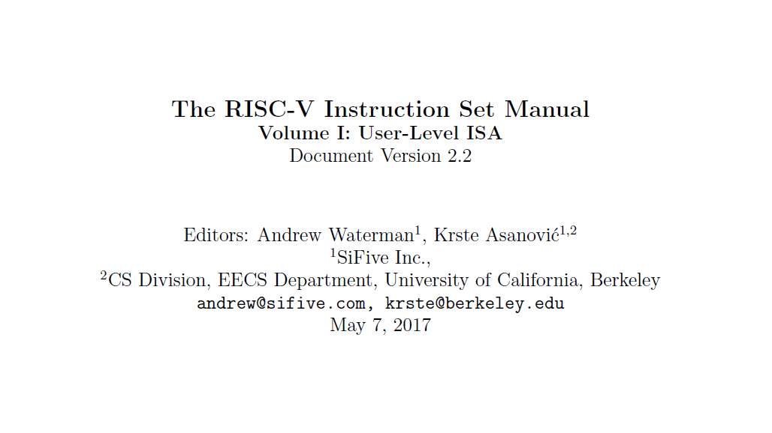
RISC-V Instruction Set Architecture (ISA)

Slide 14
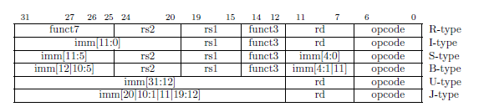
RISC-V Instruction Formats
From Page 104

Slide 15
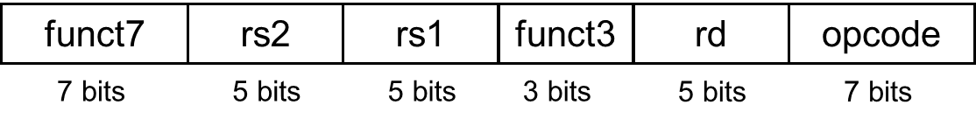
RISC-V R-type instructions
The layout of the instruction is called the instruction format
Each segment in the instruction is called a field
Instruction fields
opcode: operation code (format e.g. R-type is a function of the opcode)
rd: destination register number
funct3 (or fn3): 3-bit function code (additional opcode)
rs1: the first source register number
rs2: the second source register number
funct7 (or fn7): 7-bit function code (additional opcode)

Slide 16
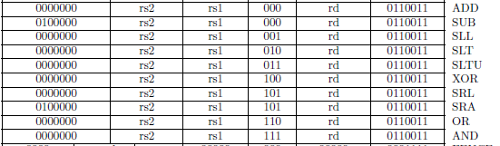
RISC-V R-type Instruction Formats
All OPCODEs are the same – select R-type
FN3 defines the basic ALU operation
FN7 defines additional instructions

Slide 17
RISC-V I-type instructions
immediate
rs1
funct3
rd
opcode
12 bits
5 bits
3 bits
5 bits
7 bits
Immediate arithmetic and load instructions
rs1: source or base address register number
immediate: constant operand, or offset added to base address
2s-complement, sign extended

Slide 18
RISC-V I-type instruction example
immediate
rs1
funct3
rd
opcode
12 bits
5 bits
3 bits
5 bits
7 bits
rd rs1 constant
addi x5, x0, 1024
<rd> = <rs1> + 1024
opcode + funct3 define the instruction as addi
1024
0
funct3
5
opcode
12 bits
5 bits
3 bits
5 bits
7 bits

Slide 19
RISC-V I-type instruction example
immediate
rs1
funct3
rd
opcode
12 bits
5 bits
3 bits
5 bits
7 bits
rd constant rs1
lw x5, 32(x18)
<rd> = memory(<rs1> + 32)
opcode + funct3 define the instruction as lw
32
18
funct3
5
opcode
12 bits
5 bits
3 bits
5 bits
7 bits

Slide 20
RISC-V I-type instruction example
immediate
rs1
funct3
rd
opcode
12 bits
5 bits
3 bits
5 bits
7 bits
rd constant rs1
jalr x5, 32(x18)
<rd> = PC + 4
PC = <rs1> + constant

Slide 21
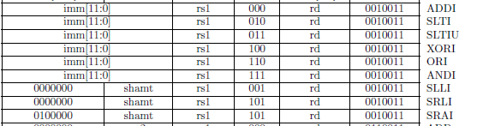
RISC-V I-type Immediate Instruction Formats
All OPCODEs are the same – select I-type immediate
FN3 defines the basic ALU operation
Same as equivalent R-type operation
Shift immediates only 5/6-bits
FN7 defines additional shift instructions

Slide 22

RISC-V I-type Load Instruction Formats
All OPCODEs are the same – select I-type load
NOTE: Adjacent to 0010011 of I-type immediate format (1 bit difference)
FN3 defines the type of load

Slide 23
RISC-V I-type JALR Instruction Formats
OPCODE – selects I-type jalr
NOTE: Not adjacent to others
FN3 must be 000 – allows for future instructions

Slide 24
RISC-V S-type instructions
imm[11:5]
rs2
rs1
funct3
imm[4:0]
opcode
7 bits
5 bits
5 bits
3 bits
5 bits
7 bits
Different immediate format for store instructions
rs1: base address register number
rs2: source operand register number
imm(ediate): offset added to base address – split for alignment with other instructions
Need rs2 but not rd
Keep rs2 in the same place in all instructions

Slide 25
RISC-V S-type Store Instruction Formats
All OPCODEs are the same – select S-type store
FN3 defines the type of store (same as for load)
rs2 is in the standard location
Immediate field is split to allow rs2

Slide 26
RISC-V Memory Store Operation Details
Assume x7 contains 0x12345678
Assume x6 contains 0x500
sw x7, 0x20(x6) - what address?
What changes in memory?
0
1
2
3
0x520
a
b
c
d
0x524
e
f
g
h
0x528
i
j
k
l
0x52C
m
n
o
p
Data in Memory

Slide 27
RISC-V Memory Store Operation Details
Assume x7 contains 0x12345678
Assume x6 contains 0x500
sw x7, 0x20(x6) - what address?
What changes in memory?
sh x7, 0x26(x6) – what address?
What changes in memory?
0
1
2
3
0x520
78
56
34
12
0x524
e
f
g
h
0x528
i
j
k
l
0x52C
m
n
o
p
Data in Memory

Slide 28
RISC-V Memory Store Operation Details
Assume x7 contains 0x12345678
Assume x6 contains 0x500
sw x7, 0x20(x6) - what address?
What changes in memory?
sh x7, 0x26(x6) – what address?
What changes in memory?
sb x7, 0x2d(x6) – what address?
What changes in memory?
0
1
2
3
0x520
78
56
34
12
0x524
e
f
78
56
0x528
i
j
k
l
0x52C
m
n
o
p
Data in Memory

Slide 29
RISC-V Memory Store Operation Details
Assume x7 contains 0x12345678
Assume x6 contains 0x500
sw x7, 0x20(x6) - what address?
What changes in memory?
sh x7, 0x26(x6) – what address?
What changes in memory?
sb x7, 0x2d(x6) – what address?
What changes in memory?
0
1
2
3
0x520
78
56
34
12
0x524
e
f
78
56
0x528
i
j
k
l
0x52C
m
78
o
p
Data in Memory

Slide 30
RISC-V Memory Load Operation Details
Assume x6 contains 0x500
lw x7, 0x2C(x6) - what goes to x7?
0x87547827
lhu x7, 0x24(x6) – what goes to x7?
0x0000BC9A
lh x7, 0x24(x6) – what goes to x7?
0xFFFFBC9A
lbu x7, 0x2F(x6) – what goes to x7?
0x00000087
lb x7, 0x21(x6) – what goes to x7?
0x00000056
0
1
2
3
0x520
78
56
34
12
0x524
9A
BC
78
56
0x528
i
j
k
l
0x52C
27
78
54
87
Data in Memory

Slide 31
RISC-V: B-type Instructions
imm [10:5]
rs2
rs1
funct3
imm [4:1]
opcode
imm[12]
imm[11]
B-type (SB-type in the textbook)
Branch instructions specify
Opcode, two registers, target address
Most branch targets are near branch
Forward or backward
PC-relative addressing
Target address = PC + immediate × 2
Example of Making the Common Case Fast

Slide 32
RISC-V: B-type Instructions
imm [10:5]
rs2
rs1
funct3
imm [4:1]
opcode
imm[12]
imm[11]
Why times 2??
A branch addresses an instruction
Instructions are at least 16 bits (32 in our design)
So on a 16-bit boundary
Addresses are therefore even, i.e. bit 0 is always 0
So don’t need bit 0, and can extend the branch distance with bit 12
Move bit 11 for alignment with other instructions

Slide 33
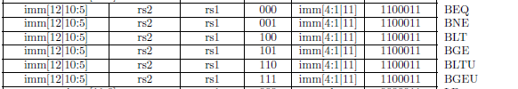
RISC-V B-type Branch Instruction Formats
All OPCODEs are the same – select B-type branch
FN3 defines the type of branch
Offset (immediate) is arranged to maximize alignment with other formats
Offset has no bit 0 – times 2 addressing

Slide 34
RISC-V: J-type Instruction (JAL)
Jump and link (JAL) instruction uses 20-bit immediate
J-type (UJ type in textbook)
Offset is times 2 just as for branches
For long jumps, e.g., to 32-bit absolute address 0x12345678
lui x8, 0x12345: load address[31:12] to temp register x8
jalr x0, 0x678(x8): add address[11:0] and jump to target
imm[10:1]
imm[19:12]
rd
opcode
5 bits
7 bits
imm[20]
imm[11]

Slide 35
RISC-V J-type Instruction Formats
OPCODE – selects J-type jal (no FN3)
NOTE: Adjacent to jalr
Branch offset scrambled to optimize alignment with other formats

